Slide 1
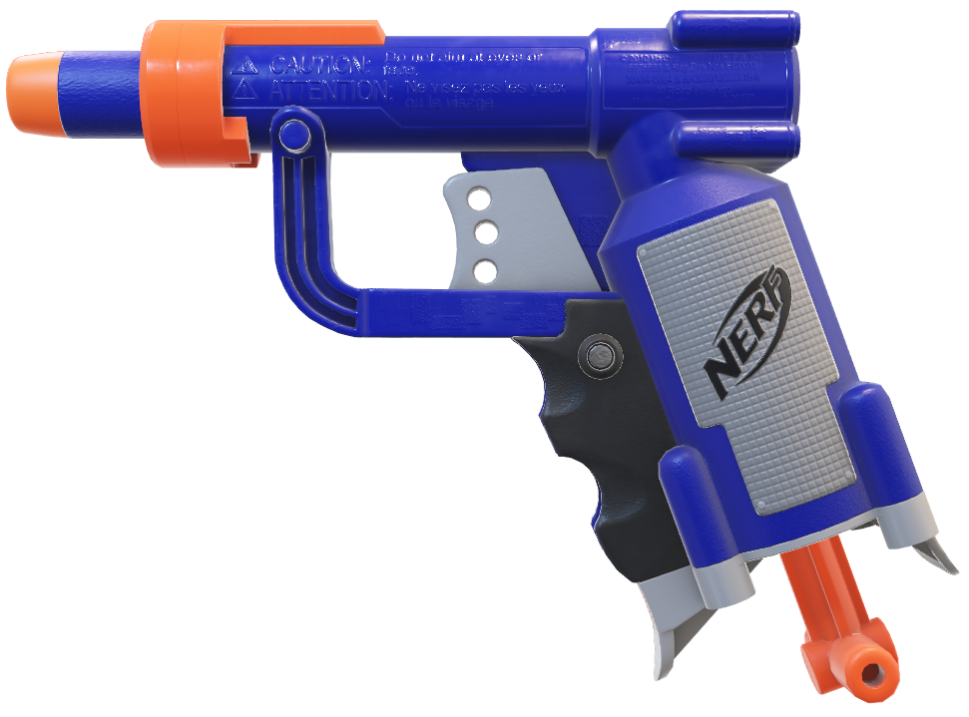
A.I GUN

Slide 2
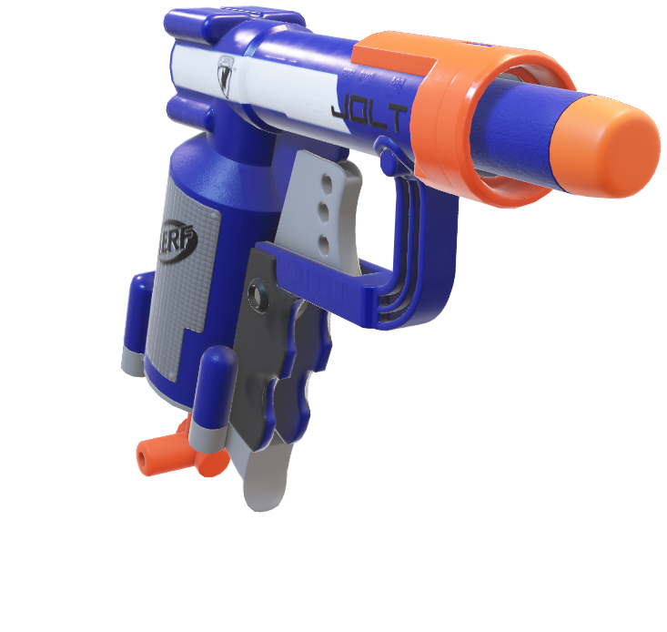
The AI gun is an advanced auto-targeting system that utilizes artificial intelligence to verify intruders. It takes input references from the user, such as facial features or specific markers, and swiftly identifies intruders. Upon verification, the gun automatically targets the intruder's head for precision. This innovative technology enhances security measures by providing quick and accurate responses to potential threats.

Slide 3
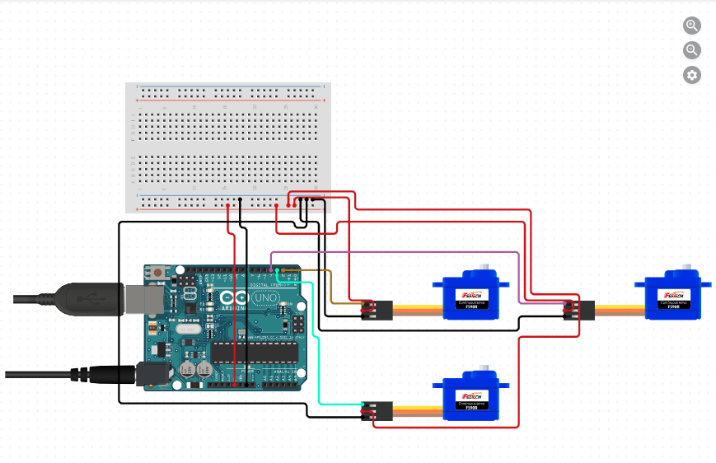
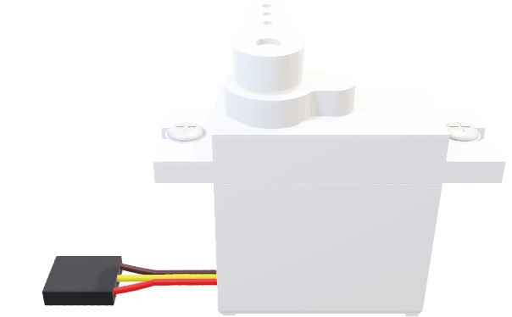
MOTION
The basic design structure will be as follows: three servos two of which would be for pan and tilt and one will be for trigger action for our project a basic 9g Servo motors are taken which are then connected to an Arduino Board

Slide 4

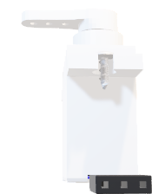
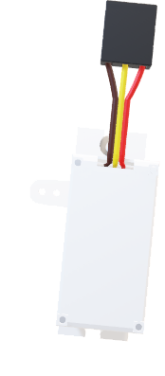
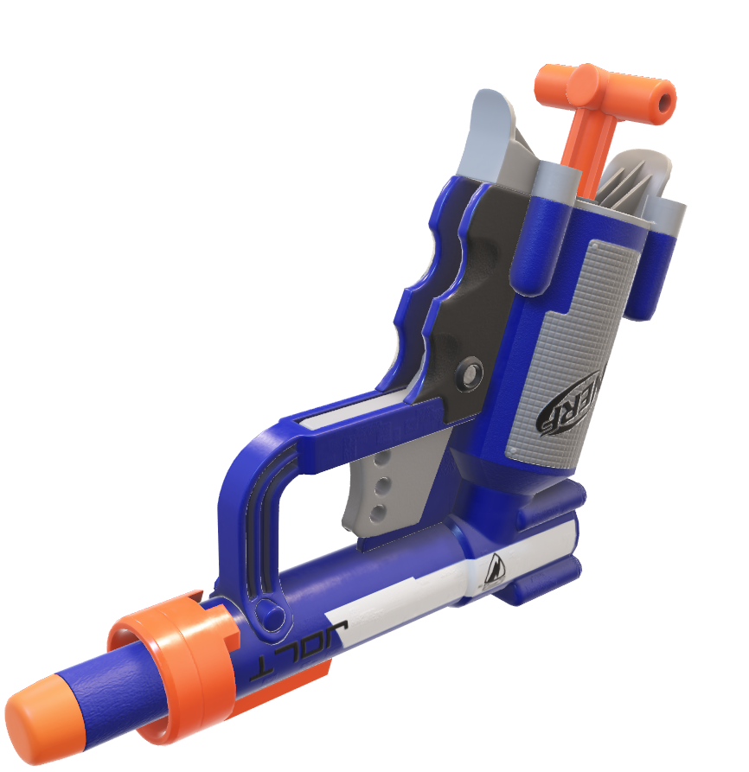
STRUCTURE
For building this model we used spiral report model for imporving the model in every iteration increasing accuracy in structure stability and target detection.
For tilt action
For Pan action

Slide 5

Object Detection and Recognition: Pinpointing Potential Threats
1
Sophisticated Object Detection
2
Deep Learning Models
AI GUN's advanced object detection capabilities can accurately identify a wide range of objects, including people, vehicles, and weapons, in real-time video streams. This enables security personnel to quickly identify and assess potential threats.
Backed by deep learning algorithms trained on extensive datasets, AI GUN's object recognition models achieve remarkable accuracy in identifying and classifying detected objects, ensuring reliable threat identification.
3
Adaptable to Evolving Threats
4
Comprehensive Threat Awareness
The system continuously learns and adapts, allowing it to keep pace with changing threat landscapes and detect emerging threats with exceptional precision.
By combining object detection and recognition, AI GUN provides a comprehensive view of the security environment, empowering security teams to make informed decisions and respond effectively to potential risks.

Slide 6
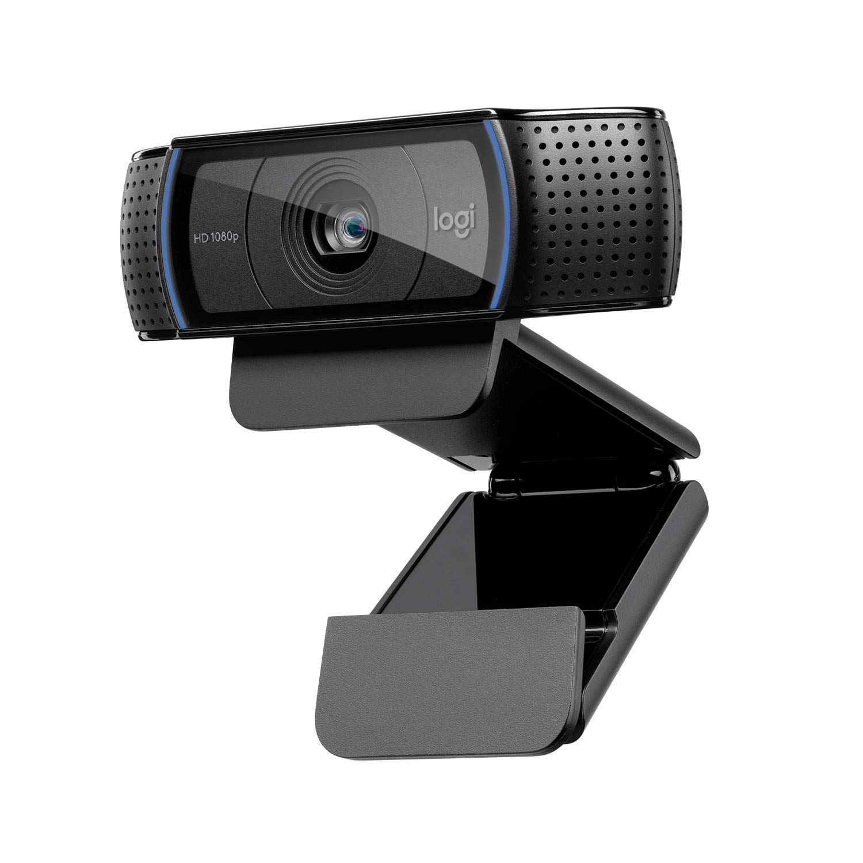
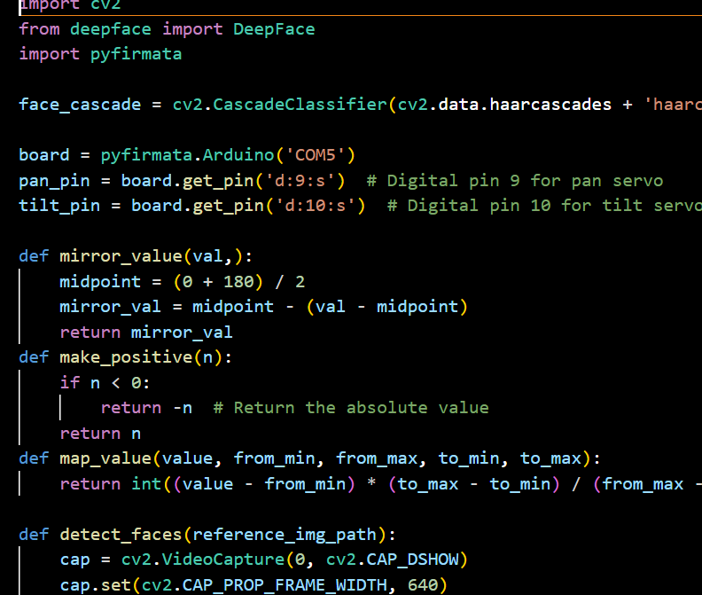

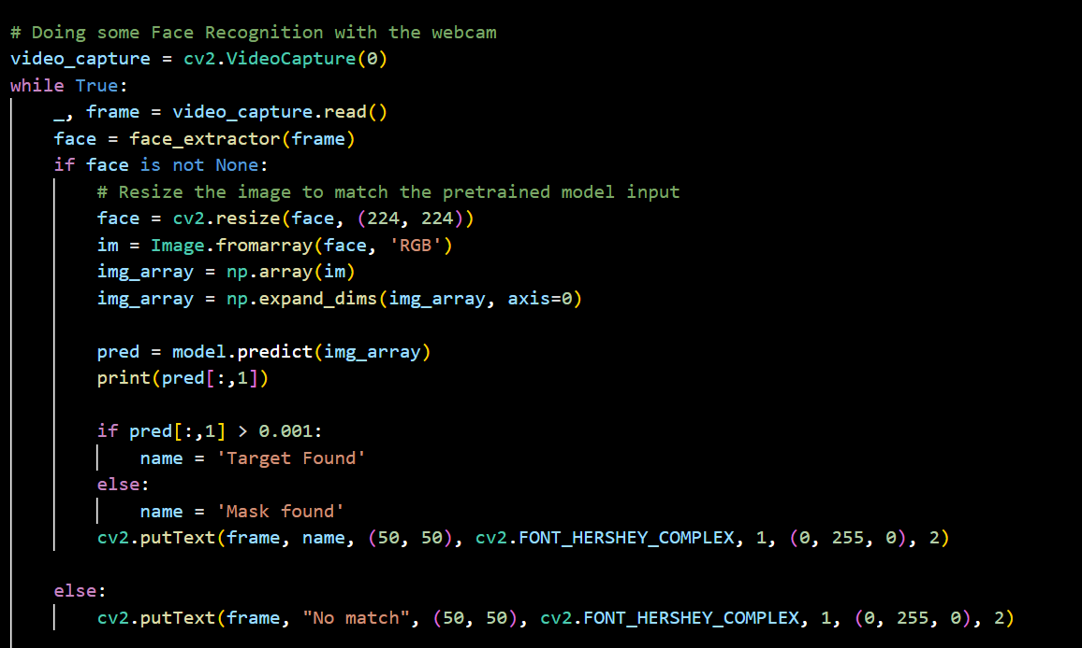
Sends coordinates to Arduino using pyfirmata communication
Webcam takes input image
Interprets if its classified target

Slide 7
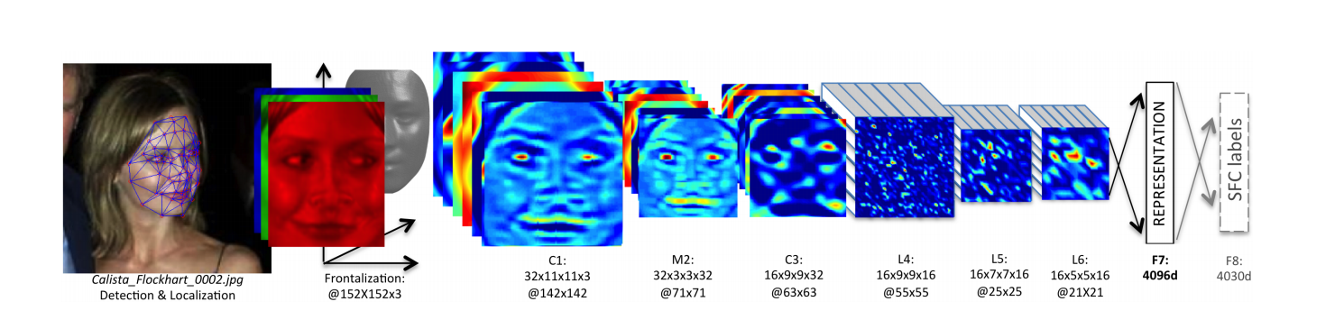
Modeling has being trained for mask or no-mask for target detection and deepface has also being used for specific face detection

Slide 8
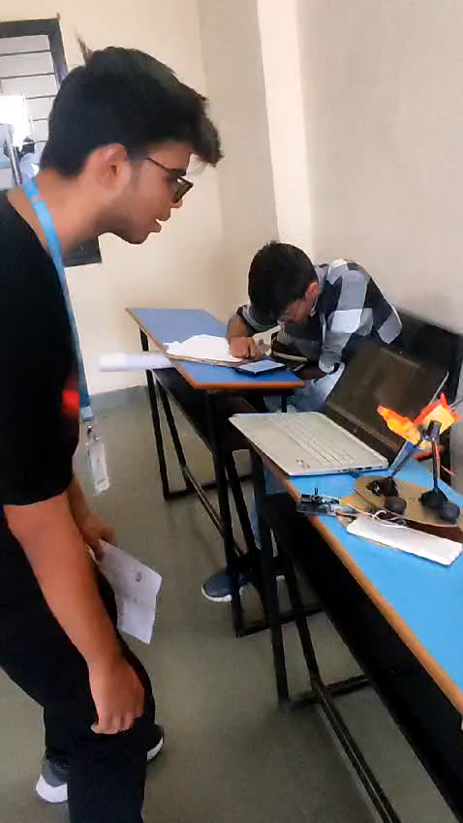
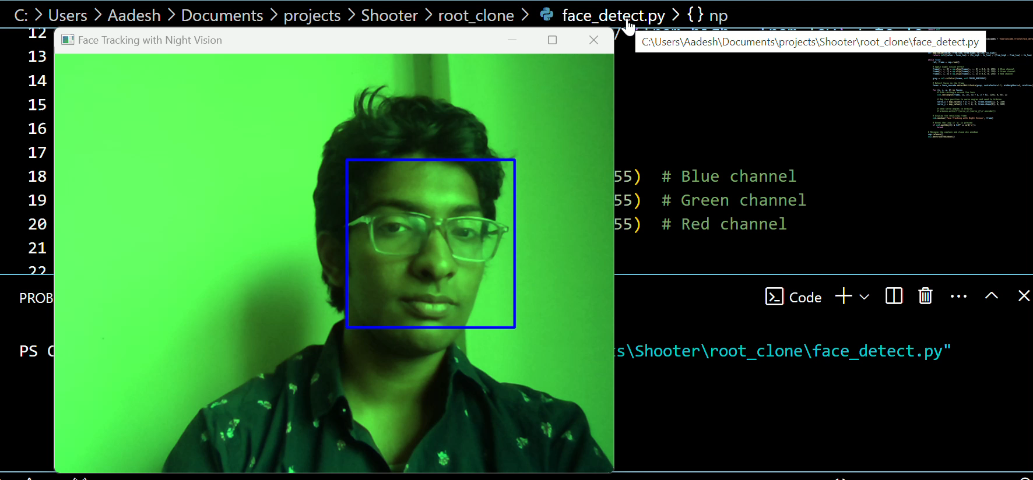
Using high quality night-vision camera the face training model can be even better for night mode
Face tracking and recognition has a whopping accuracy of 92% ,the tracking is done by face region extraction

Slide 9
Enhanced Security and Operational Efficiency
Improved Accuracy
Faster Response Times
AI GUN's advanced computer vision and machine learning capabilities offer unparalleled accuracy in detecting and recognizing potential threats, reducing the likelihood of false alarms and ensuring that security personnel can focus on genuine risks.
By automating the threat detection and assessment process, AI GUN enables security teams to respond to emergencies more quickly, minimizing the impact of incidents and enhancing overall organizational resilience.
Reduced Reliance on Manual Monitoring
Improved Resource Allocation
By providing real-time intelligence and insights, AI GUN helps security teams optimize the deployment of personnel, equipment, and other resources, ensuring that they are allocated effectively to address the most pressing security concerns.
With AI GUN's autonomous threat detection and alert generation capabilities, security organizations can reduce the burden on human operators, allowing them to focus on strategic decision-making and coordinating effective responses.

Slide 10
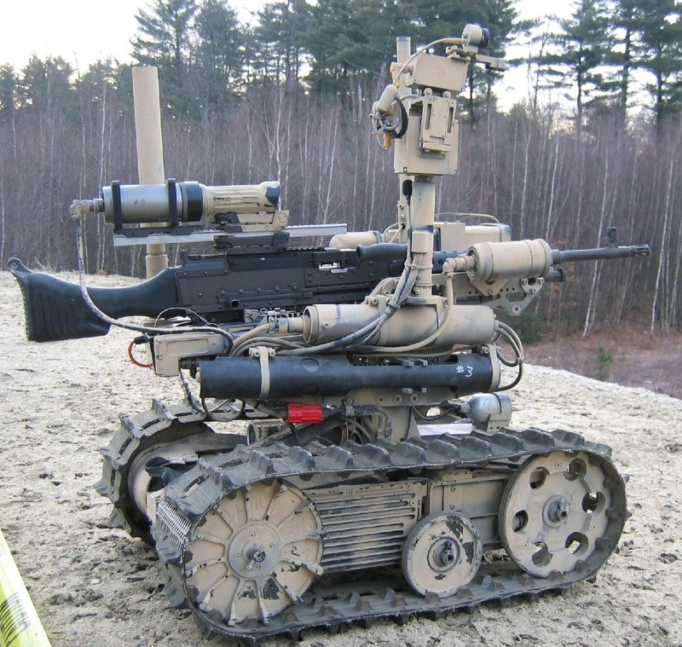
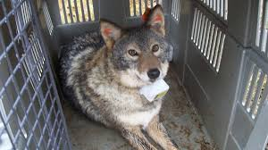
FUTURE SCOPE
Implementing the AI gun in military bases can significantly enhance security by providing automated intruder detection and response capabilities. It can be integrated into existing surveillance systems to provide real-time threat detection and precise targeting, increasing the overall effectiveness of base security.
The AI gun can also be used for animal tranquilization in zoo’s and various purposes where animal attacks are frequent and are critical areas for example Coyote attacks in U.S or Leopard attacks in Maharashtra this Gun can be installed in zoo’s and pistol can be substituted by tranquilizer.(Using Models for animals)

Slide 11
THANK YOU

